Slide 1
Chapter 7
Java Database Connectivity JDBC

Slide 2
Java Database Connectivity JDBC
What is JDBC?
JDBC Drivers
Opening a connection
A simple connection
Result sets
SQLException Handling

Slide 3
What is JDBC?
JDBC is an API for the Java programming language that defines how a client may access a database.
It provides methods for querying and updating data in a database.
JDBC is oriented towards relational databases.

Slide 4
What is JDBC?
JDBC connections support creating and executing statements.
These may be update statements such as SQL's CREATE, INSERT, UPDATE and DELETE, or they may be query statements such as SELECT.
Update statements such as INSERT, UPDATE and DELETE return an update count that indicates how many rows were affected in the database. These statements do not return any other information.

Slide 5
What is JDBC?
Query statements return a JDBC row result set.
The row result set is used to walk over the result set.
Individual columns in a row are retrieved either by name or by column number.
There may be any number of rows in the result set.
The row result set has metadata that describes the names of the columns and their types.

Slide 6
JDBC Drivers
JDBC drivers are client-side adapters (installed on the client machine, not on the server) that convert requests from Java programs to a protocol that the DBMS can understand.
There are four types of drivers available:
Type 1 Driver - JDBC-ODBC bridge
Type 2 Driver - Native-API Driver
Type 3 Driver - Network-Protocol Driver
Type 4 Driver - Native-Protocol Driver
We will only be dealing with type 4.

Slide 7
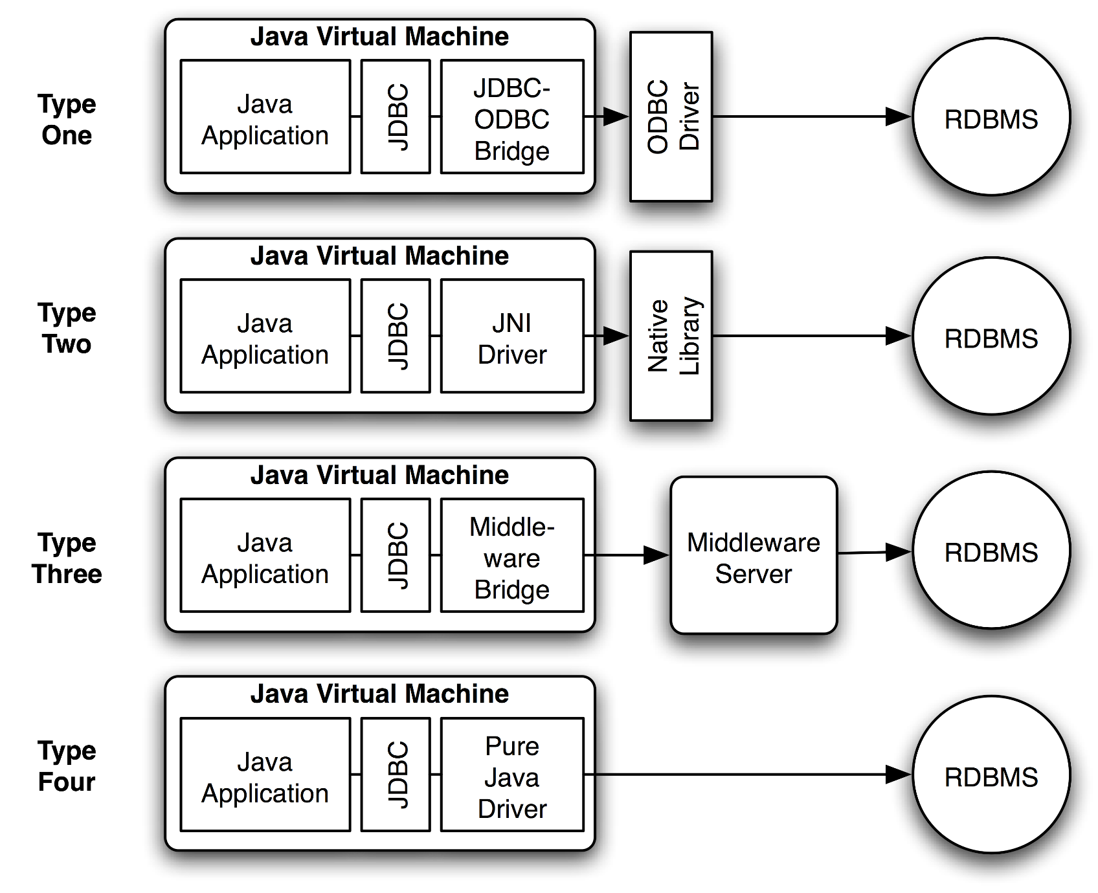
JDBC Drivers

Slide 8
Type 4 Driver
The JDBC type 4 driver, also known as the Database-Protocol driver, is a database driver implementation that converts JDBC calls directly into a vendor-specific database protocol (e.g. MySQL, Oracle, SQL Server etc.).
The type 4 driver is written entirely in Java so its interfaces are platform independent. This means it doesn’t need an installation on the client machine.
The type 4 driver provides better performance than types 1 or 2 as it doesn’t need to convert into ODBC or database API calls

Slide 9
Type 4 Driver
Advantages
Better performance than Type 1 or 2 Driver
Platform independent
Disadvantages
Drivers are database dependent so you need a specific driver for whatever database you’re using, in our case -MySQL

Slide 10
Where is the driver for MySQL?
A copy is up on moodle in the Lab section
It can also be downloaded from the following website:
http://dev.mysql.com/downloads/connector/j/
We’ll add the driver to the Build Path of our Java project as shown on the following slides.

Slide 11
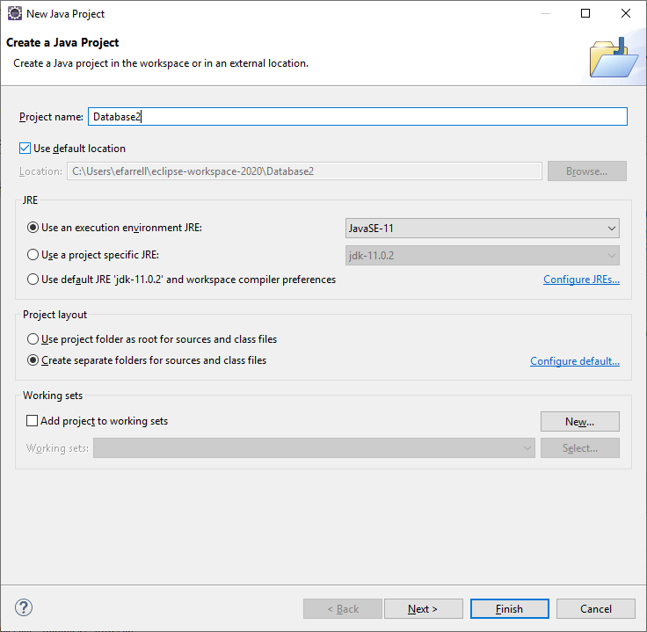
Create a new Java project

Slide 12
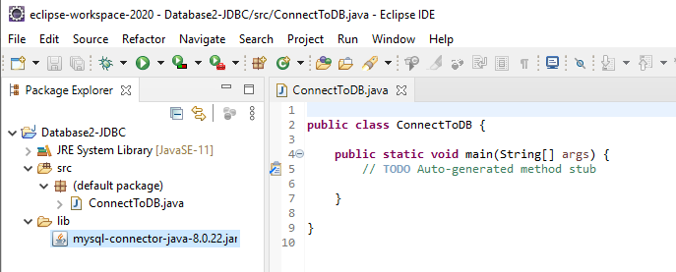
What do I do with the driver?
Make a new folder called ‘lib’ in your project
Copy (drag and drop) the mysql-connector jar file into the folder:

Slide 13
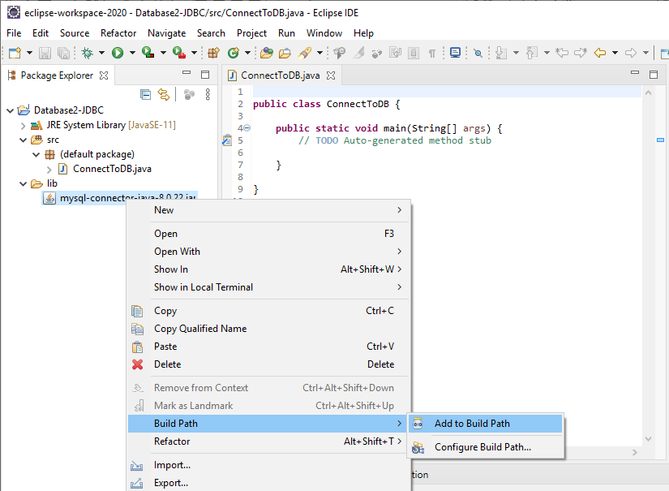
Add the driver to the build path
Right click on the jar file and add to build path as shown below:

Slide 14
JDBC steps
Connect to database
Query database (or insert/update/delete)
Process results
Close connection to database

Slide 15
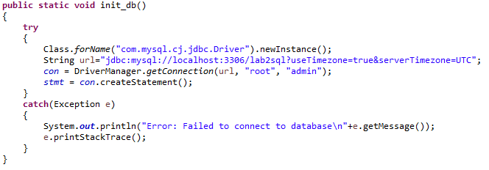
1: Connect to Database
It is easiest to create a method that does all of the work for us. We can use this for any database we create, just change the database name, user and password.

Slide 16
1: Connect to Database
The following line of code loads the driver:
The URL is in a particular format
Format: “jdbc:<subprotocol>:<subname>”
We’re connecting to the local machine on port 3306 (default for MySQL)
We’re connecting to the database called lab2sql (Videostore)

Slide 17
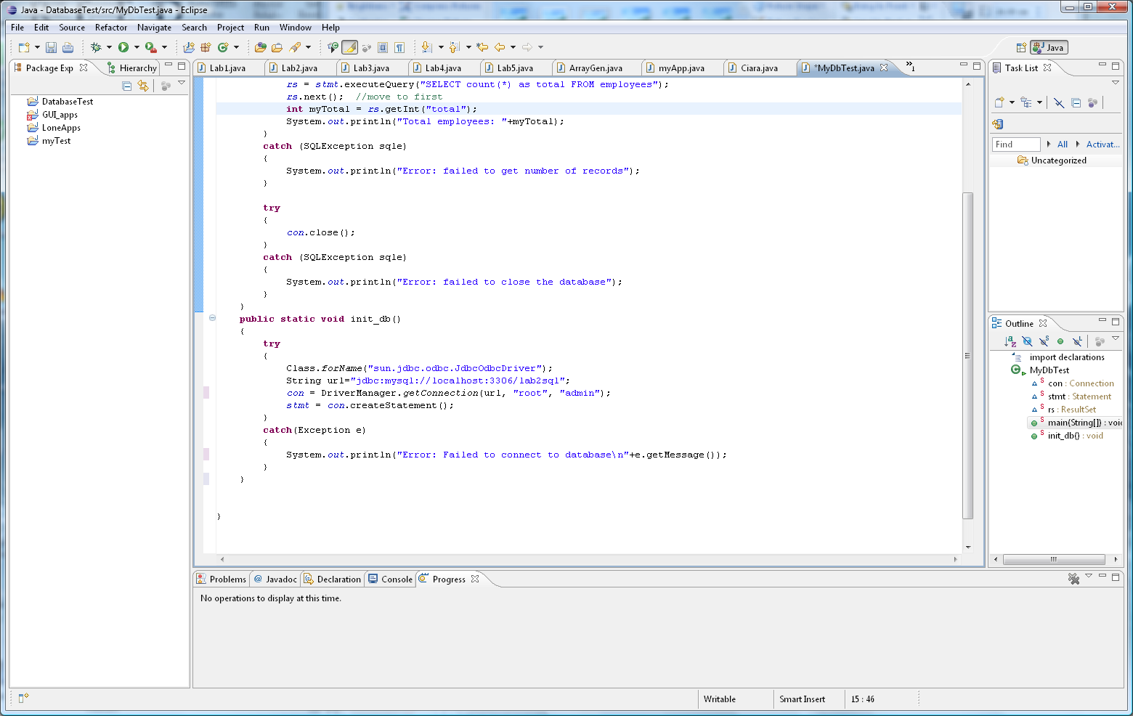
1: Connect to Database
The driver manager is used to make the JDBC connection, it accepts the parameters of the URL (seen on previous slide) and the name and password of the user making the connection.
Finally with the connection made above, we create a Statement object which allows us to send commands to the database.

Slide 18
2: Query database
public static void main(String[] args)
{
init_db(); // open the connection to the database
try
{
rs = stmt.executeQuery("SELECT count(*) as total FROM employees");
rs.next();//move to first row, the query above only produces 1 row
int myTotal = rs.getInt("total");
System.out.println("Total employees: "+myTotal);
}
catch (SQLException sqle)
{
System.out.println("Error: failed to get number of records");
}
try
{
con.close();
}
catch (SQLException sqle)
{
System.out.println("Error: failed to close the database");
}
}

Slide 19
2: Query database
rs = stmt.executeQuery("SELECT count(*) as total FROM employees");
stmt object sends SQL commands to database
Methods
executeQuery() for SELECT statements
executeUpdate() for INSERT, UPDATE, DELETE, statements
Send SQL statements
stmt.executeQuery(“SELECT …”);
stmt.executeUpdate(“INSERT …”);
The SQL statement that we send is simply a String and no more than that.

Slide 20
3: Process Results
The result of a SELECT statement is returned as a ResultSet object (rows/columns)
ResultSet rs = stmt.executeQuery("SELECT * FROM employees");
Step through each row in the result
rs.next()
Get column values in a row
String userid = rs.getString(“emp_id”);
double type = rs.getDouble(“rate”);

Slide 21
Print the employee Table
while (rs.next()) {
int empid = rs.getInt(1);
String firstname = rs.getString("firstName");
String lastname = rs.getString("lastName");
String address1= rs.getString(4);
double rate= rs.getDouble("rate");
System.out.println(empid + " " + firstname + " " + lastname + " " + address1+ " " + rate);
}
The above code will go through all the records that have been returned to the result set.
As can be seen, you can use column names or numbers to specify which value you want.

Slide 22
Adding a record to employees
Recall how we inserted an entry into the database:
INSERT INTO employees VALUES ( null, 'Joe', 'Mullins', 'Big long Road',null, 'Athlone', '08712345678', '1980-12-21', 'M', 'Manager', 24.99);
We can use a prepared statement to insert a row as follows:
String str =
"INSERT INTO employees VALUES(null,?, ?, ?, ?, ?, ?, ?, ?, ?, ?)";
PreparedStatement pstmt = con.prepareStatement(str);
pstmt.setString(1, "Joe");
pstmt.setString(2, "Mullins");
… [fill in the other values here..]
pstmt.setDouble(10, 24.99);
// Returns number of rows inserted
int rows = pstmt.executeUpdate();

Slide 23
4: Close the connection
Close the ResultSet object
rs.close();
Close the Statement object
stmt.close();
Close the connection
con.close();

Slide 24
Complete code (concluded on the next slide)
import java.sql.*;
public class ConnectToDB
{
static Connection con = null;
static Statement stmt = null;
static ResultSet rs = null;
public static void main(String[] args)
{
init_db(); // open the connection to the database
try
{
rs = stmt.executeQuery("SELECT count(*) as total FROM employees");
rs.next();//move to first, the query above only produces 1 tuple
int myTotal = rs.getInt("total");
System.out.println("Total employees: "+myTotal);
}
catch (SQLException sqle)
{
System.out.println("Error: failed to get number of records");
}
try
{
con.close();
}
catch (SQLException sqle)
{
System.out.println("Error: failed to close the database");
}
}

Slide 25
Complete code
public static void init_db()
{
try
{
Class.forName("com.mysql.cj.jdbc.Driver");
String url="jdbc:mysql://localhost:3306/lab2sql?useTimezone=true&serverTimezone=UTC";
con = DriverManager.getConnection(url, "root", "admin");
stmt = con.createStatement();
}
catch(Exception e)
{
System.out.println("Error: Failed to connect to database\n" + e.getMessage());
}
}
}

Slide 26
SQLException Handling
As can be seen from the completed code, whenever we interact with the database an SQL exception is automatically thrown so we need to catch it.
When an SQL exception is thrown, the best we can do is let the user know that whatever they were doing caused an error.
Since it is a String that is passed to the database, the String may be valid but the SQL may not, it is only when the String is sent will the exception occur.

Slide 27
SQLException Handling
The most common error here is when input is required from the user and the String created from the resultant input does not create a valid SQL expression.
Make sure to check if you’re inserting the correct number of columns!

Slide 28
Exercise 1
Create a new class (PrintTables.java) that prints out the employee and customer tables.
Use slide 21 as the basis for the solution.

Slide 29
Exercise 2
Create a new class (AddEmployee.java) that adds a new employee to the Employee table.
Use slide 22 as the basis for the solution.

Slide 30
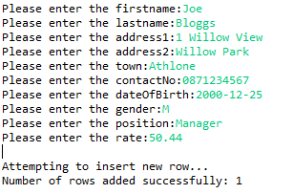
Exercise 3
Create a new class (AddEmployee2.java) that prompts the user to enter the values for a new employee and then adds that new employee to the Employee table.
This solution will build on what you did in Exercise 2.

